Slide 1
The PBR Guide
By: SHI Yi

Slide 2
Why do we need PBR workflow?

Slide 3
What are the benefits?
PBR provides a workflow for creating consistent artwork, even between different artists.
When using hand-painted methods—which were common in the game industry over ten years ago—there is no consistent standard, as it depends heavily on each artists’ painting skills and personal perception. For a project involving many artists, it becomes challenging due to the varying levels of artists’ skills.

Slide 4
What are the benefits?
PBR removes the guesswork of authoring surface attributes and provides a powerful means of accurately representing different materials.
Hand painting and describing each type of materials is very challenging—only high skilled artists can clearly portray the differences between metal, skin, jade, silk and more. However, using PBR workflow makes this process much easier.

Slide 5
What are the benefits?
Assets will look accurate in all lighting conditions.
Almost all game studios working on realistic games adopt PBR. Even many stylized games also take inspiration from it. Therefore, it’s essential for us to keep up with industry standards.

Slide 6
What is the standard?

Slide 7
What is the standard?
There are several PBR workflows, the difference between them are quite nuanced. We are going to use BaseColor, Metallic, Roughness map and follow Unreal physically based Materials system. Other workflows and theory will not be introduced.

Slide 8
What is PBR?

Slide 9
What is PBR?
Physically based rendering (PBR) models is based on Lighting theory and ray model of light. The shader itself solves some calculations automatically. The textures and materials we author interact with light in our virtual worlds. We create textures to describe a surface instead of drawing what we see.
Therefore, as long as you are following the PBR workflow, please do not paint any lighting information directly on the textures.

Slide 10
What is PBR?
BaseColor: The reflected wavelengths are what we see as a color.
E.g. the skin of an apple mostly reflects red light
Specular reflection is independent of wavelength, so for dielectrics as an apple, it also has bright specular highlights the same color as the light source
Color represents albedo for non-metal materials and reflectance values for metals.

Slide 11
What is PBR?
Metals: The reflectance value for polished metal is high at a range -of about 70-100% reflective. For the dielectric (non-metal) reflectance will be 2-5% when you gaze at it (F0).
If the metal rusts, this changes the reflective state of the metal. The corroded areas are then treated as a dielectric material denoted by a black value in the metallic map (But In practice, you can give a little amount of metallic and we will discuss the practice part later in this guide)
Painted metal is treated as a dielectric rather than a metal. The paint acts as a layer on top of the raw metal. Only the raw metal exposed from chipped paint is treated as metal. The same goes for dirt on metal or any matter that obscures the raw metal.

Slide 12
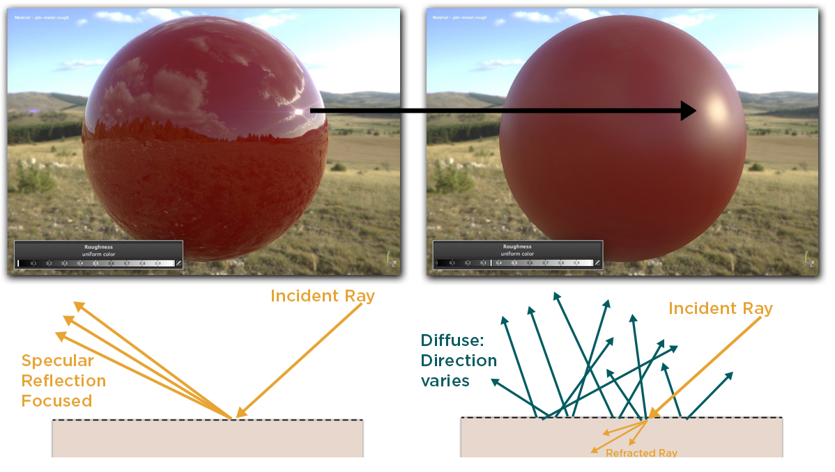
What is PBR?
Roughness: Rougher surfaces will have highlights that are larger, and that appear dimmer. Smoother surfaces will keep specular reflections focused, and they will appear to look brighter or more intense when viewed from the proper angle. However, the same total amount of light is reflected in both cases.

Slide 13
How to follow PBR?

Slide 14
Workflow
Is the surface METAL? Yes
Metallic Map:
Black (0.0) is non-metal and white (1.0) is metal. There can be transitional grayscale values to account for oxidation(rust) or dirt.
Paint is a nonmetal, so the Metallic value should be 0.0 in any regions covered by paint. Anywhere the metal panel is visible, the Metalic value should be 1.0. Paint does not blend with metal, it sits on top of it. Your Metallic map should not contain intermediate grayscale values, only black and white.

Slide 15
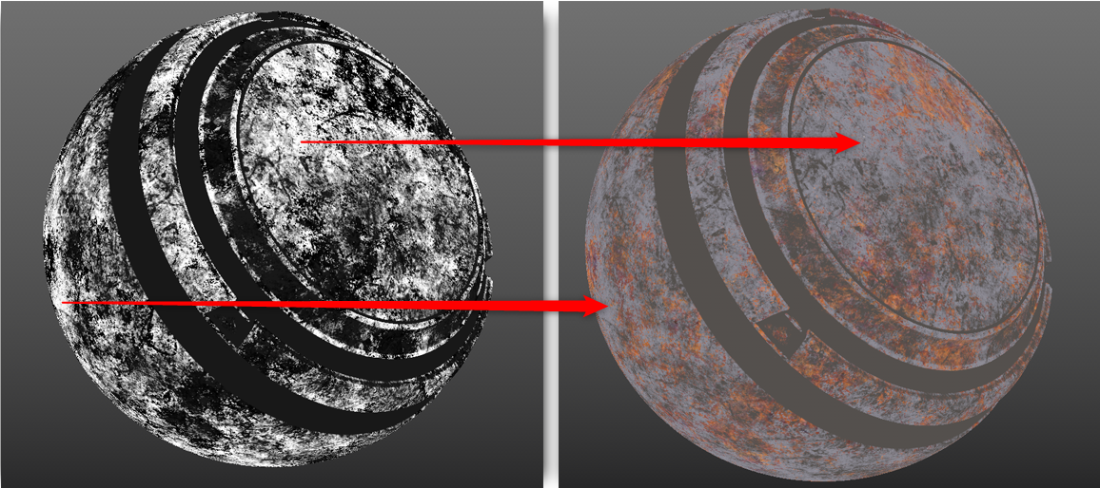
Workflow
Is the surface METAL? Yes
Metallic Map: (Rusted Metal)

Slide 16
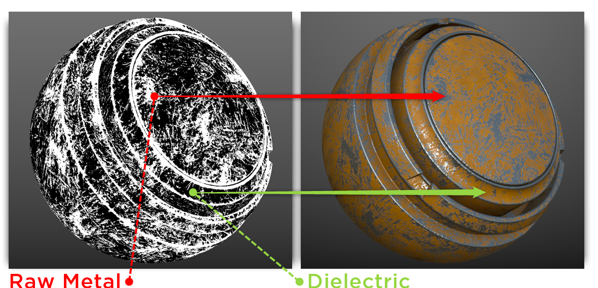
Workflow
Is the surface METAL? Yes
Metallic Map: (Painted Metal)

Slide 17
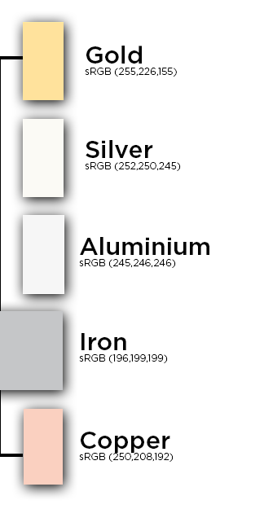
Workflow
Is the surface METAL? Yes
BaseColor Map:
Reflectance for raw metal is going to be high, in the range of 70-100% specular, which we can map to 180-255 sRGB. Values that indicate the reflectance values for metals should be obtained from real-world measured values.
Base color should be devoid of lighting information with the exception of micro-occlusion.

Slide 18
Workflow
Is the surface METAL? NO
BaseColor Map:
For dark values, you should not go under 30-50 sRGB. The range for dark values could be more tolerant at 30 sRGB and stricter at 50 sRGB. For bright colors, you should not have any values that are higher than 240 sRGB.
For this project, your range should fall within 30-240 sRGB, which equals 0.02-0.81 on a linear 0-1 scale. Charcoal has the darkest albedo found in real life, and Fresh Snow has the brightest albedo found in real life

Slide 19
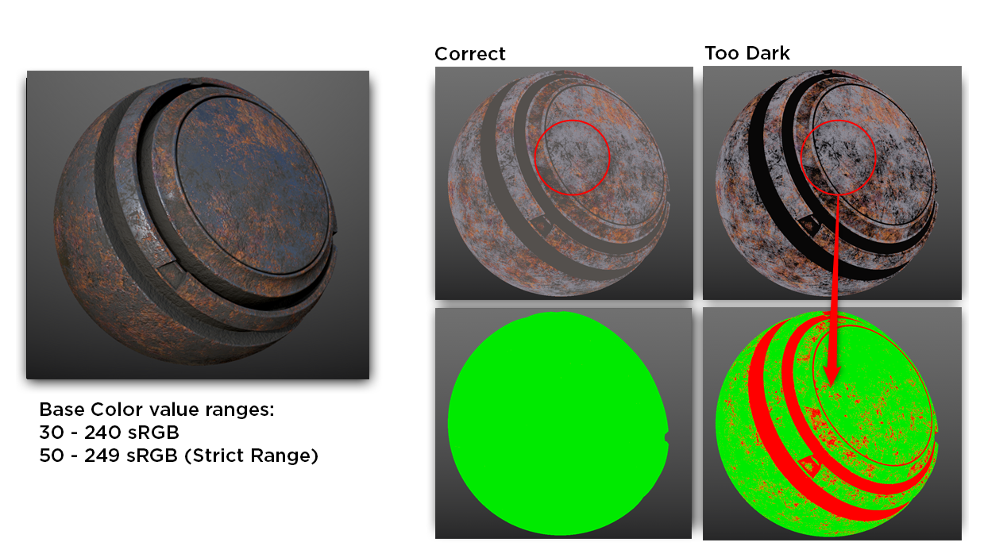
Workflow
Is the surface METAL? NO
BaseColor Map:

Slide 20
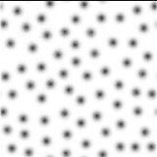
Workflow
Is the surface METAL? NO
BaseColor Map:
BaseColor Map should not contain any lighting information. There can be exceptions for adding micro-occlusion in cases where the shader would not be able to represent this level of detail with only an ambient occlusion channel.
Application: pore texture for characters

Slide 21
Workflow
Is the surface METAL? NO
Metallic Map: 0.0 (black)

Slide 22
Workflow
For all types of surfaces
Roughness Map: black (0.0) represents a smooth surface and white (1.0) represents a rough surface.
The roughness map is the most creative map as it allows the artist to visually define the character of a surface. It allows you to creatively tell a story about the condition of a surface.
Technically, it is correct to use any value between 0-1 for roughness, but it's worth avoiding the hard limit of 0 and 1 for most materials. Do check the scene as a whole and compare the assets in relation to each other.

Slide 23
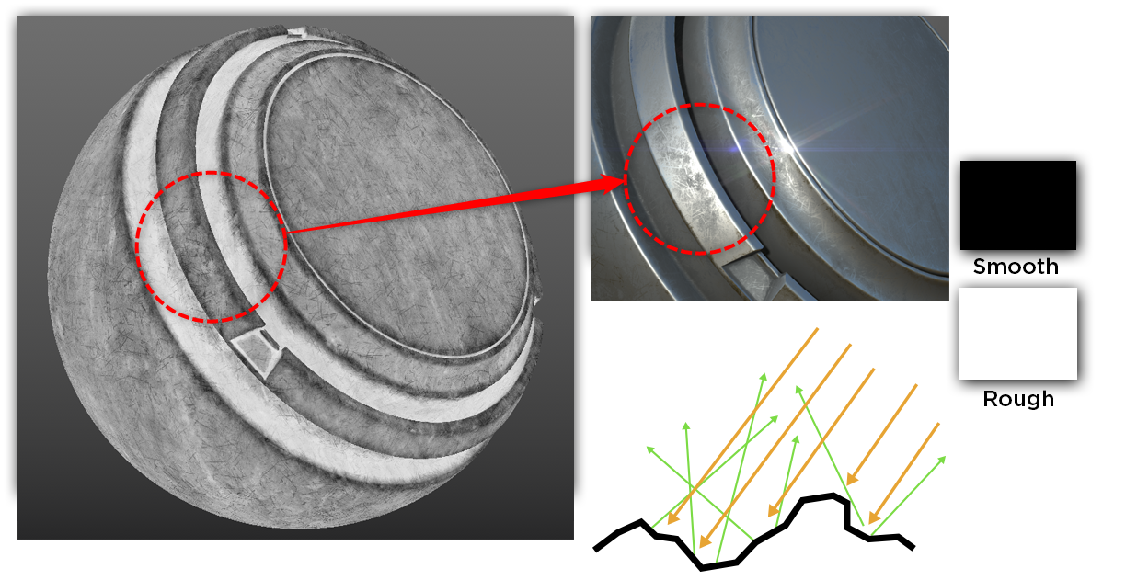
Workflow
For all types of surfaces
Roughness Map
Dusty areas should have higher roughness, which means they appear whiter on the roughness map

Slide 24
Q&A

Slide 25
Q&A
Q: Should I follow this workflow strictly?
A: You should normally because each map is guided by physical principles. There may be some minor tweaks based on art direction or project needs, but everything stays within a reasonable range. For some stylized art, it is geared more towards art direction rather than a strictly physical model. It is important to know the principles without being slaves to them.
Q: I’ve noticed there are some other types of maps, like the cavity map, displacement map etc. Do I need to use them?
A: You only need BaseColor, Metallic, Roughness, Normal, Ambient Occlusion for 95% of materials. These maps are designed for special materials or visual effects, typically when conventional maps are not sufficient to describe a surface.
Q: How can I learn to make texture correctly?
A: As I am not a texture artist, I can not provide specific artist advice. The best way is to study how others create textures when you are unfamiliar with a surface like watching video tutorials or exploring Unreal Engine asset packs to examine how others handle texture details. The latter is the one I recommend the most.

Slide 26
What do I want you to do?

Slide 27
My Advice
As artists, we need to think differently about the maps that describe the attributes of a surface. Always check every map for accuracy. Be sure to review them under Base Color, Roughness, Metallic and Normal view modes.
Approach your work from a PBR workflow perspective and consider everything through the textures. For example, a groove in a wooden plank should collect dust. Dust generally has a higher roughness value than wood, so the roughness map in that area should be whiter. Additionally, ensure the groove on the normal map appear recessed, not raised.
Every problem must be solved. Ideally, you would have a senior artist review your work, but since we don’t have one, you’ll rely on your own intuition and judgement. If you notice anything visually incorrect but you do not know the reason, you should ask me. Never assume that “Unreal Engine is just like this” or “I’m a student, so it’s okay if there’s an issue.”

Slide 28
Reference
Adobe Learn - Learn Substance 3D Designer The PBR Guide - Part 1
Adobe Learn - Learn Substance 3D Designer The PBR Guide - Part 2
Physically Based Materials in Unreal Engine | Unreal Engine 5.3 Documentation | Epic Developer Community
ArtStation - Unreal Engine - PBR Value Checker 2.0

